Slide 1

Data Visualization of Bird Strikes between 2000 – 2011
A Visual Analysis of Bird Strikes on Aircrafts
Aditya Singh

Slide 2
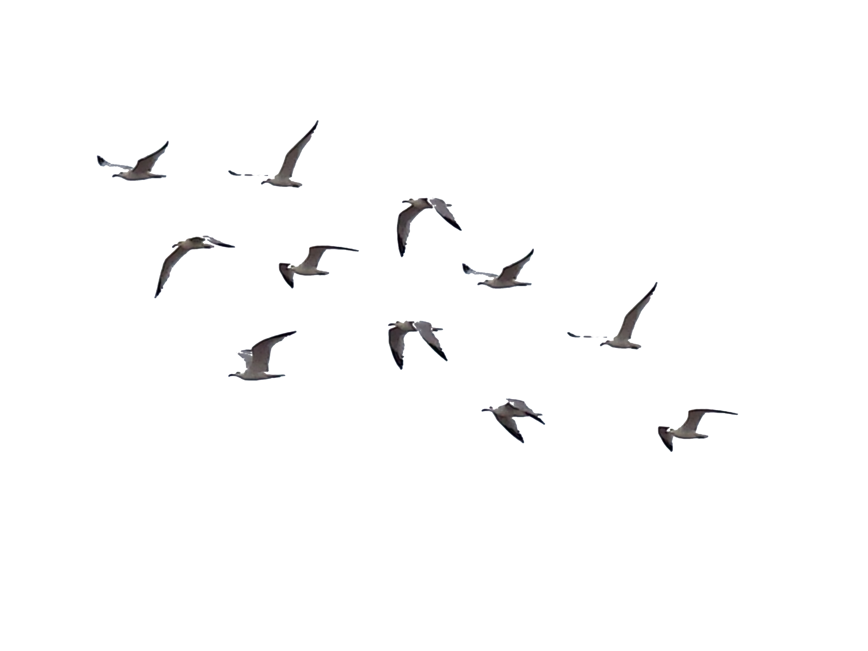
Introduction
A Little about Bird Strikes, why it happens and why it needs to be studied..

Slide 3

Placeholder Title 0
Imagine hurtling through the air and suddenly colliding with a goose! Bird strikes, though uncommon accidents, can be dangerous.
They happen because airplanes and birds share airspace, especially during takeoff, landing, and low-altitude flights.
Studying bird strikes visually with tools like radar helps us understand bird migration patterns and flocking behavior. Data science comes in to crunch all this information - pinpointing high-risk areas and times for bird strikes.
By analyzing this visual data along with weather patterns and airport activity, we can pinpoint high-risk areas and times for bird strikes. It's like joining the dots to predict where these unfortunate mid-air meetings might occur. This knowledge helps airlines adjust flight paths and airport authorities implement bird dispersal techniques, keeping both feathered friends and metal birds safe.

Slide 4
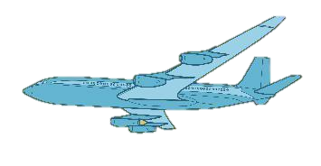
Description of Data

Slide 5

Placeholder Title 01
Record ID: Unique identifier for the bird strike incident.
Aircraft Type: Passenger plane, cargo plane, etc.
Airport Name: Where the bird strike occurred (if applicable).
Altitude bin: Low, medium, or high altitude during the incident.
Make/Model: Specific aircraft model involved (e.g., Boeing 737).
Wildlife Struck (estimated/actual): Number of birds involved
Impact to flight: Disrupted flight (diverted, etc.) or continued normally.
Flight Date: Date of the bird strike incident.
Indicated Damage: Whether the aircraft sustained damage.
Engines: Number of engines on the aircraft.
Airline/Operator: The airline involved in the incident.
Origin State: State where the flight originated from.
Phase of flight: Takeoff, landing, etc. during the incident.
Precipitation: Rain, snow, etc. at the time of the incident.
Wildlife remains collected: Whether bird remains were collected.
Sent to Smithsonian: Whether remains were sent for further analysis.
Remarks: Any additional notes or details about the incident.
Wildlife Size: Size of the bird(s) involved (e.g., small, large).
Sky Conditions: Cloud cover (clear, cloudy, etc.) at the time.
Wildlife Species: Type of bird involved (if identified).
Pilot Warned: Whether the pilot received a warning about birds.
Cost: Total monetary cost of the damage caused by the bird strike.
Feet above ground: Aircraft's altitude in feet at the time of impact.
People Injured: Number of people injured in the incident (if any).
Large Aircraft: Categorizes the aircraft size (large or small).

Slide 6
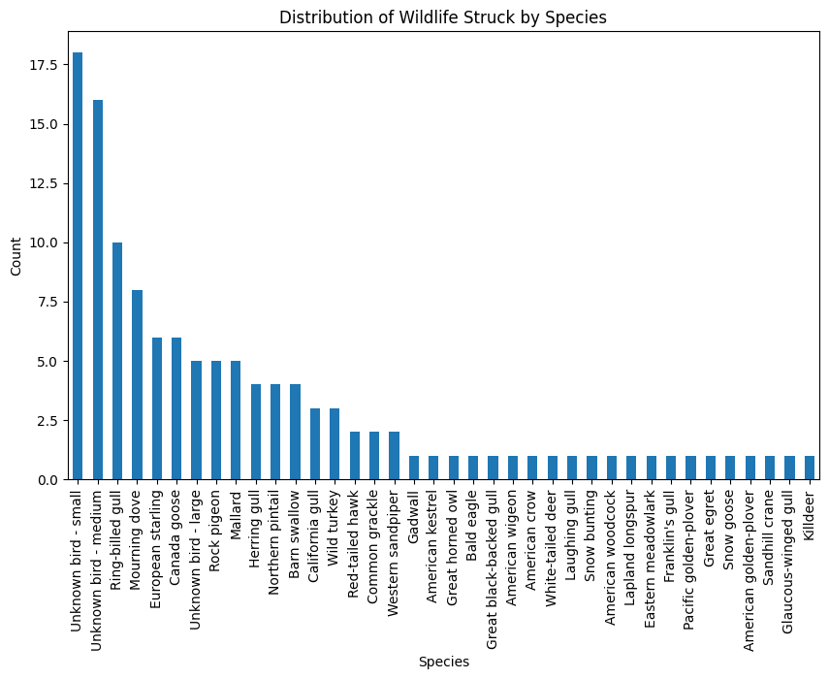
The chart displays the distribution of wildlife species struck, with the x-axis representing different species and the y-axis representing the count of incidents. "Unknown bird - small" and "Unknown bird - medium" have the highest counts, followed by species like Ring-billed gull and Mourning dove. The counts decrease gradually for other species, indicating a higher frequency of strikes involving unknown and common bird species.

Slide 7
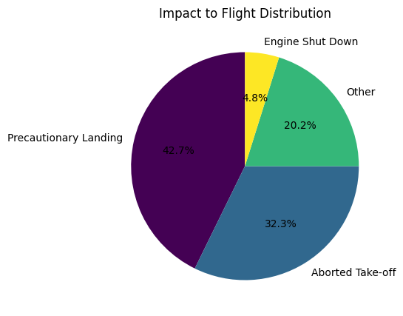
The pie chart illustrates the distribution of the impact on flights caused by wildlife strikes. The largest segment, 42.7%, represents precautionary landings. Aborted take-offs account for 32.3%, while 20.2% of impacts fall under the "Other" category. Engine shut-downs are the least common, constituting 4.8% of the total. This chart highlights that precautionary landings and aborted take-offs are the most frequent responses to wildlife strikes, indicating significant disruptions to flight operations.

Slide 8
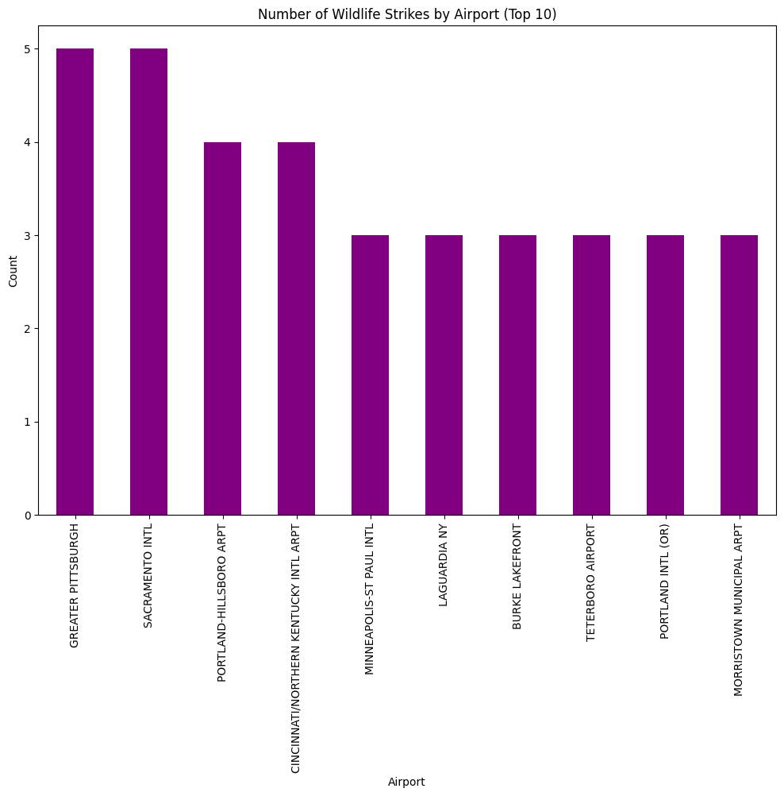
The bar chart presents the top 10 airports by the number of wildlife strikes. Greater Pittsburgh and Sacramento International airports both have the highest count, with 5 strikes each. Following them are Portland-Hillsboro, Cincinnati/Northern Kentucky International, and Minneapolis-St Paul International airports, each with 4 strikes. LaGuardia, Burke Lakefront, Teterboro, Portland International (OR), and Morristown Municipal airports each reported 3 strikes. This chart highlights the airports most frequently affected by wildlife strikes, with a relatively even distribution among the top contenders.

Slide 9

Visual Dashboard
A Visual Representation of the data in PowerBI

Slide 10
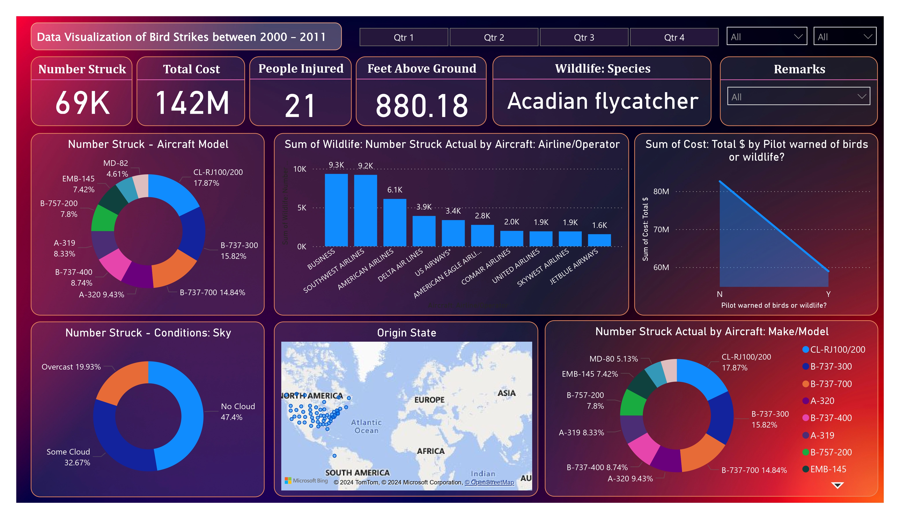
Placeholder Title 04

Slide 11
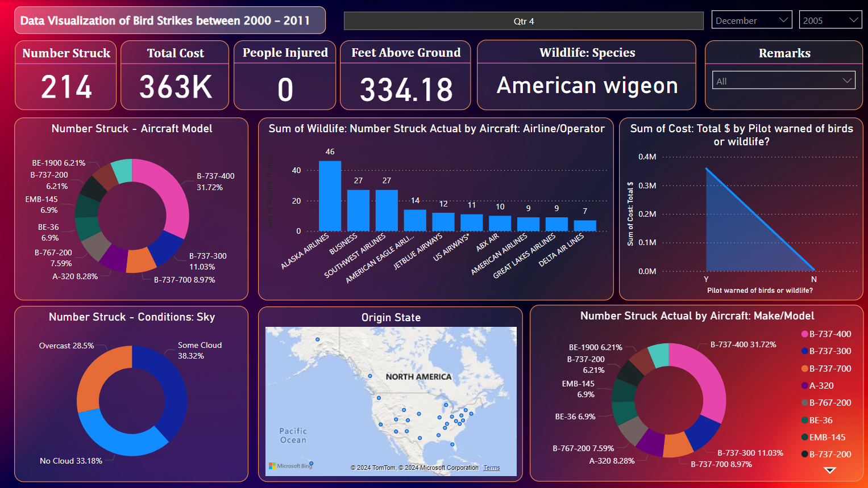
Placeholder Title 04

Slide 12
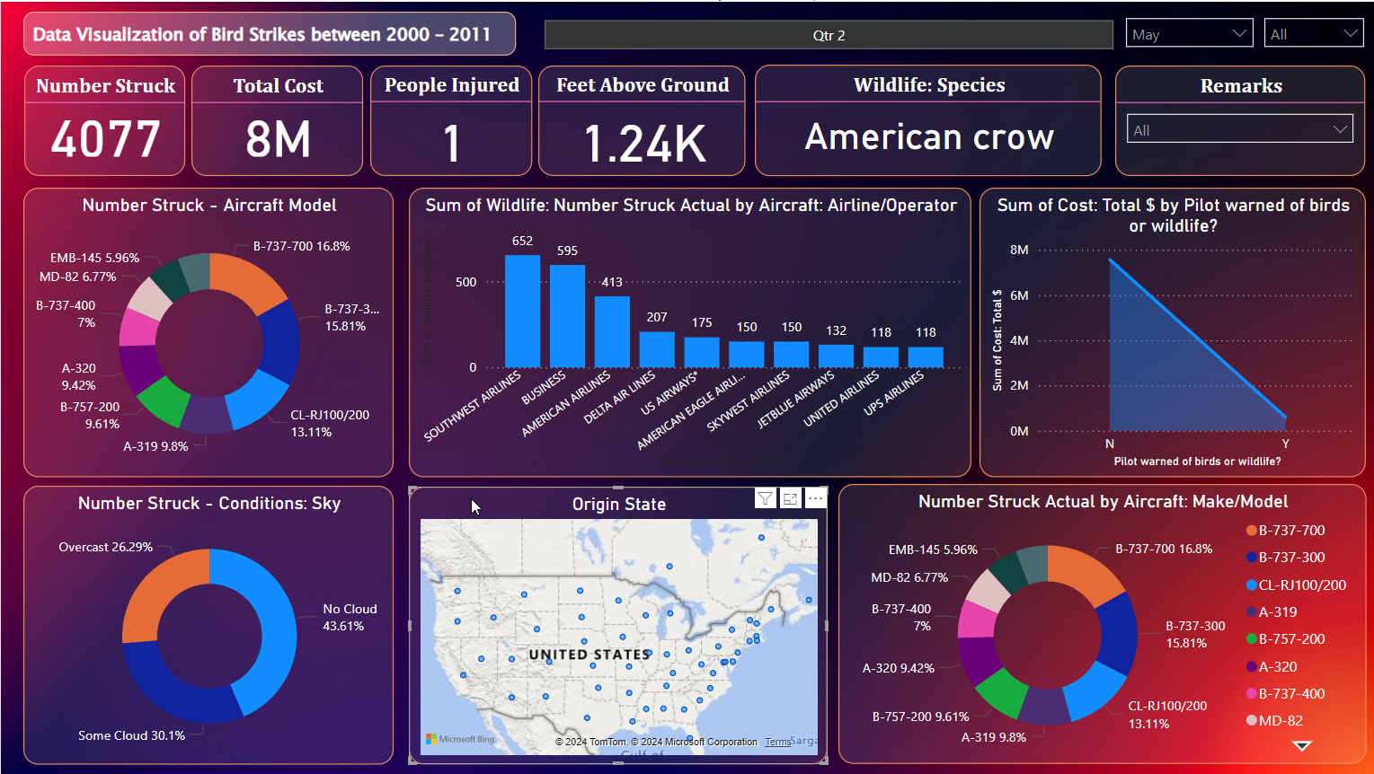
Placeholder Title 04

Slide 13

Thank You

